Slide 1

ACA Risk Adjustment EHR Data Validation Tool
FHIRed Up
Augusto Burgos|Spiro Ganas | Anja Guillory | Jamie Richgels | Daniel Stoneburner | Tala Suidan
Notes:
The FHIRed Up Team is developing an electronic health record data validation tool. This tool will help providers verify a patient’s current list of diagnoses. Accurate diagnosis data will insure that providers are fairly compensated under the affordable care act’s risk adjustment program.

Slide 2
Risk Scores & Adjustment
Risk Scores are an estimate of an individual’s future medical costs. Recent diagnostic history is the most important data in determining an individual’s risk score. Other predictors include the individual’s geographic area, age/gender and the type of insurance policy (high-deductible, low co-pays, etc.)
Risk Selection occurs when insurers try to avoid enrolling unhealthy people by making their products unattractive to people requiring costly medical care.
Risk Adjustment discourages risk selection by transferring premiums from insurers with healthy members to those with members who are more ill.
Notes:
The Affordable Care Act requires health insurance companies to offer insurance to people with pre-existing conditions. By only offering policies with high co-pays and high-deductibles, insurance companies can discourage ill patients from purchasing their products. Risk adjustment reduces the incentive for risk selection by transferring premiums from insurers with healthy members to those insurers who are caring for a more ill population.
Risk scores are use to determine the average level of illness in an insurers population. A diabetic with heart failure will have a risk score substantially higher than someone without any chronic conditions. While several factors are used in the risk score calculation, a patient’s recent diagnosis history is the most heavily-weighed factor.

Slide 3
Business Case
If a member has an illness, but the diagnosis code is not reported to the insurance carrier during the calendar year, their risk score will be artificially low.
This data quality issue can substantially reduce an insured's premiums. When provider payments are on a percent-of-premium basis, it also reduces payments to hospitals and doctors.
As doctors and hospitals move to a pay-for-performance structure, correct risk assessment and diagnostic codes ensure appropriate payment for treatment of patients with multiple chronic diseases.
American Health Lawyers Association recommends the following strategies
Know high revenue HCCs that are often undiagnosed or undercoded
Review missing diagnoses from prior years’ HCCs and send reminders to MDs
Audits of records vs. codes for missing codes: last year and this year.
Conduct annual comprehensive exams for members who have not yet been seen early in the year.
Source: https://www.healthlawyers.org/Events/Programs/Materials/Documents/MM12/papers/EE_haley_sillman_slides.pdf
Notes:
If a member has an illness, but the diagnosis code is not reported to the insurance carrier during the calendar year, their risk score will be artificially low.
This data quality issue can substantially reduce an insured's premiums. When provider payments are on a percent-of-premium basis, it also reduces payments to hospitals and doctors.
As doctors and hospitals move to a pay-for-performance structure, correct risk assessment and diagnostic codes ensure appropriate payment for treatment of patients with multiple chronic diseases.
In 2015, 61 million dollars of premium was transferred between Massachusetts insurance companies. Blue Cross, the states largest health insurance organization, received a 51 million dollars payment. Many smaller insurance companies argued that better data quality, rather than a sicker population, contributed to this large transfer of fund to blue cross. Fallon Health, a small insurance company that paid 11 million dollars, is an example of a company that has a strong interest in better data quality.
Source: http://www.masslive.com/news/index.ssf/2015/07/health_new_englands_26_million_risk_adjustment_fee_less_than_expected.html

Slide 4
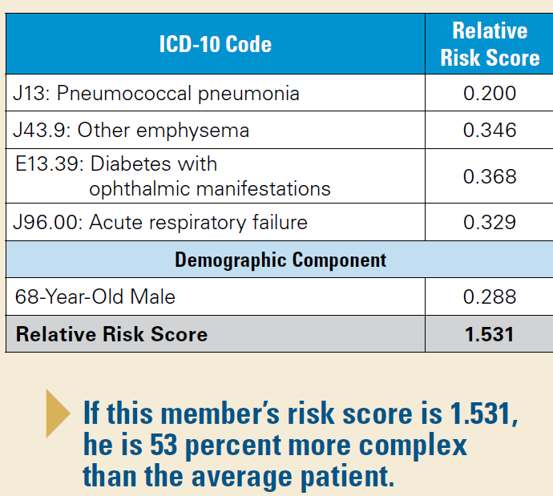
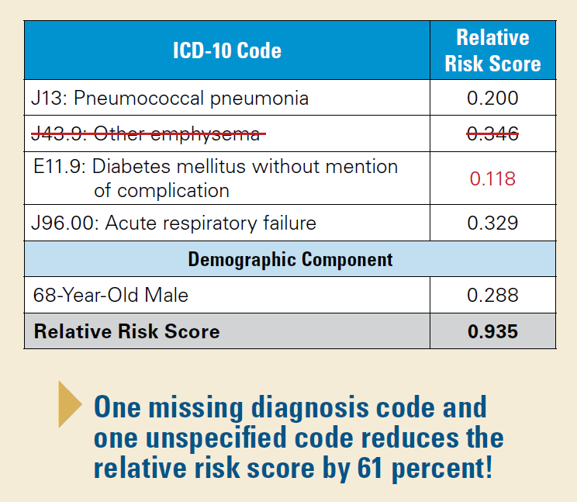
The Problem
68-year-old man with pneumonia, emphysema, diabetes with retinopathy, and respiratory failure.
Source: https://www.bcbsal.org/providers/pdfs/riskAdjustment.pdf
Notes:
Here is an example from BCBS of Alabama.
One doctor, Holly Lofton, MD, Director, Medical Weight Management Program at NYU School of Medicine said many of her patients suffer from several chronic diseases due to their obesity, but if they don’t receive treatment regularly or are not part of the same medical system, this may not be documented system and, without special attention from the doctors, result in a lower risk score, poor care coordination, and incomplete treatment.

Slide 5
The Solution
FHIR will be used to extract member IDs and diagnosis codes.
Diagnosis codes will be grouped into one of the 79 Hierarchical Condition Categories (HCC), by calendar year.
This data will then be analyzed to identify HCCs that represent chronic conditions.
When a patient sees a specialist, the FHIRed_Up tool will analyze the entered diagnostic codes and assess whether a code is missing. It will then propose the missing risks and present them to the doctor for confirmation.
Notes:
Read slide

Slide 6

Expected Results
The patients seeing a specialized doctor will have complete diagnostic codes entered facilitating coordinated care and thorough assessment.
The doctor will receive higher payment for treating and improving the health of a higher risk patient.
Image Source: http://worldartsme.com/happy-patient-clipart.html#gal_post_104304_happy-patient-clipart-1.jpg

Slide 7
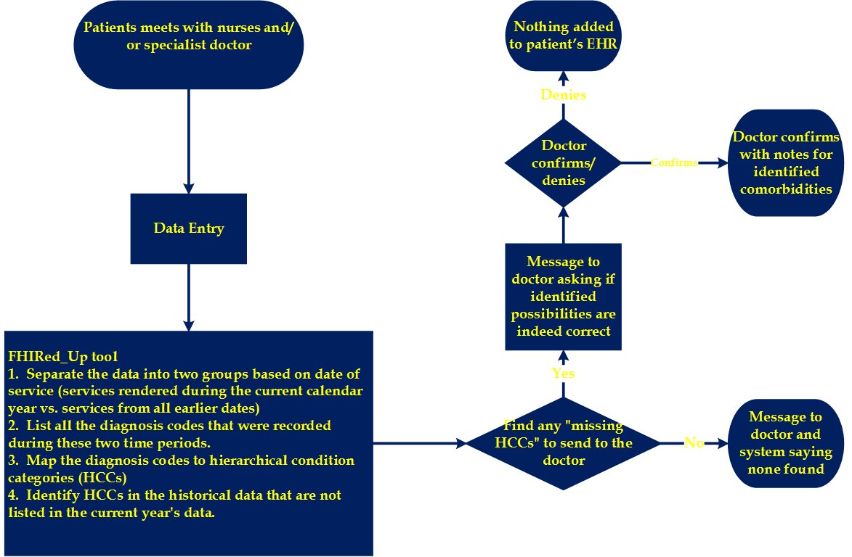
Process
Notes:
Walk through process map

Slide 8
Team Member Key Responsibilities
Augusto Burgos – Co-Lead Developer
Spiro Ganas – Project Sponsor / Developer
Anja Guillory – Co-Lead Developer
Jamie Richgels – UI testing and Business Analyst
Daniel Stoneburner – Code testing
Tala Suidan – Project Manager / Business Analyst

Slide 9
Tools & Resources Required
Google Application Engine
Georgia Tech GitHub
Georgia Tech FHIR Server
Massachusetts's APCD data dictionary
A table mapping ICD9 codes to HCCs.
Trello
Slack
Notes:
IS the APCD dictionary required if we're only concerning ourselves with the EHR and not insurance carrier systems?

Slide 10
Timeline and Milestones
Task Name | Duration | Start | Finish
Scope | 3 days | Mon 2/15/16 | Wed 2/17/16
Analysis/Software Requirements | 50 days | Thu 2/18/16 | Sat 4/2/16
Project Topic Presentation Due | 0 days | Sun 2/21/16 | Sun 2/21/16
Design, Development, & Testing in four 2-week sprints | 56 days | Thu 2/25/16 | Thu 4/14/16
Project Progress Report Due | 0 days | Sun 3/6/16 | Sun 3/6/16
Documentation | 30 days | Wed 3/23/16 | Mon 4/18/16
Project Progress Report Due | 0 days | Sun 4/3/16 | Sun 4/3/16
Deployment | 5 days | Tue 4/19/16 | Sat 4/23/16
Post Implementation Review | 3 days | Sat 4/23/16 | Tue 4/26/16
Project Due | 0 days | Sat 4/30/16 | Sat 4/30/16

Slide 11
Timeline and Milestones
* - All team members involved
† - Developers and testers involved
‡ - Business Analysts involved

Slide 12
References
Class Lectures
https://www.bcbsal.org/providers/pdfs/riskAdjustment.pdf
https://www.healthlawyers.org/Events/Programs/Materials/Documents/MM12/papers/EE_haley_sillman_slides.pdf
http://www.modernhealthcare.com/article/20150701/NEWS/150709989
http://kff.org/health-reform/issue-brief/explaining-health-care-reform-risk-adjustment-reinsurance-and-risk-corridors/

